Slide 1

Chapter 4: Threads
Operating System Concepts – 9th Edition

Slide 2
Chapter 4: Threads
Overview
Multicore Programming
Multithreading Models
Thread Libraries
Implicit Threading
Threading Issues
Operating System Examples

Slide 3
Objectives
To introduce the notion of a thread—a fundamental unit of CPU utilization that forms the basis of multithreaded computer systems
To discuss the APIs for the Pthreads, Windows, and Java thread libraries
To explore several strategies that provide implicit threading
To examine issues related to multithreaded programming
To cover operating system support for threads in Windows and Linux

Slide 4
Motivation
Most modern applications are multithreaded
Threads run within application
Multiple tasks with the application can be implemented by separate threads
Update display
Fetch data
Spell checking
Answer a network request
Process creation is heavy-weight while thread creation is light-weight
Can simplify code, increase efficiency
Kernels are generally multithreaded

Slide 5
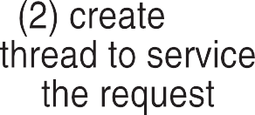

Multithreaded Server Architecture

Slide 6
Benefits
Responsiveness – may allow continued execution if part of process is blocked, especially important for user interfaces
Resource Sharing – threads share resources of process, easier than shared memory or message passing
Economy – cheaper than process creation, thread switching lower overhead than context switching
Scalability – process can take advantage of multiprocessor architectures

Slide 7
Multicore Programming
Multicore or multiprocessor systems putting pressure on programmers, challenges include:
Dividing activities
Balance
Data splitting
Data dependency
Testing and debugging
Parallelism implies a system can perform more than one task simultaneously
Concurrency supports more than one task making progress
Single processor / core, scheduler providing concurrency

Slide 8
Multicore Programming (Cont.)
Types of parallelism
Data parallelism – distributes subsets of the same data across multiple cores, same operation on each
Task parallelism – distributing threads across cores, each thread performing unique operation
As # of threads grows, so does architectural support for threading
CPUs have cores as well as hardware threads
Consider Oracle SPARC T4 with 8 cores, and 8 hardware threads per core

Slide 9
Concurrency vs. Parallelism
Concurrent execution on single-core system:
Parallelism on a multi-core system:

Slide 10
Single and Multithreaded Processes

Slide 11
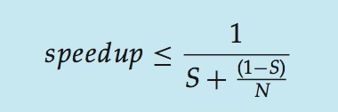
Amdahl’s Law
Identifies performance gains from adding additional cores to an application that has both serial and parallel components
S is serial portion
N processing cores
That is, if application is 75% parallel / 25% serial, moving from 1 to 2 cores results in speedup of 1.6 times
As N approaches infinity, speedup approaches 1 / S
Serial portion of an application has disproportionate effect on performance gained by adding additional cores
But does the law take into account contemporary multicore systems?

Slide 12
User Threads and Kernel Threads
User threads - management done by user-level threads library
Three primary thread libraries:
POSIX Pthreads
Windows threads
Java threads
Kernel threads - Supported by the Kernel
Examples – virtually all general purpose operating systems, including:
Windows
Solaris
Linux
Tru64 UNIX
Mac OS X

Slide 13
Multithreading Models
Many-to-One
One-to-One
Many-to-Many

Slide 14
Many-to-One
Many user-level threads mapped to single kernel thread
One thread blocking causes all to block
Multiple threads may not run in parallel on muticore system because only one may be in kernel at a time
Few systems currently use this model
Examples:
Solaris Green Threads
GNU Portable Threads

Slide 15
One-to-One
Each user-level thread maps to kernel thread
Creating a user-level thread creates a kernel thread
More concurrency than many-to-one
Number of threads per process sometimes restricted due to overhead
Examples
Windows
Linux
Solaris 9 and later

Slide 16
Many-to-Many Model
Allows many user level threads to be mapped to many kernel threads
Allows the operating system to create a sufficient number of kernel threads
Solaris prior to version 9
Windows with the ThreadFiber
package

Slide 17
Two-level Model
Similar to M:M, except that it allows a user thread to be
bound to kernel thread
Examples
IRIX
HP-UX
Tru64 UNIX
Solaris 8 and earlier

Slide 18
Thread Libraries
Thread library provides programmer with API for creating and managing threads
Two primary ways of implementing
Library entirely in user space
Kernel-level library supported by the OS

Slide 19
Pthreads
May be provided either as user-level or kernel-level
A POSIX standard (IEEE 1003.1c) API for thread creation and synchronization
Specification, not implementation
API specifies behavior of the thread library, implementation is up to development of the library
Common in UNIX operating systems (Solaris, Linux, Mac OS X)

Slide 20
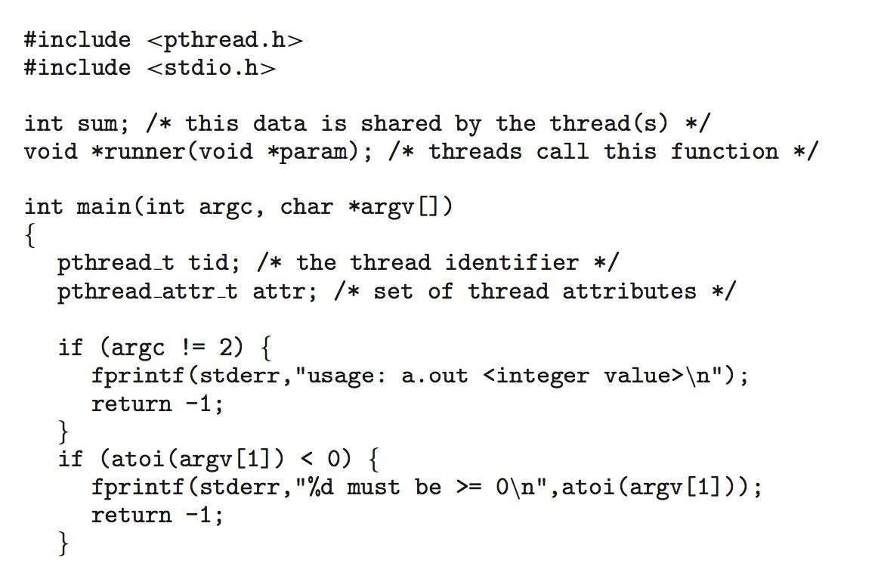
Pthreads Example

Slide 21
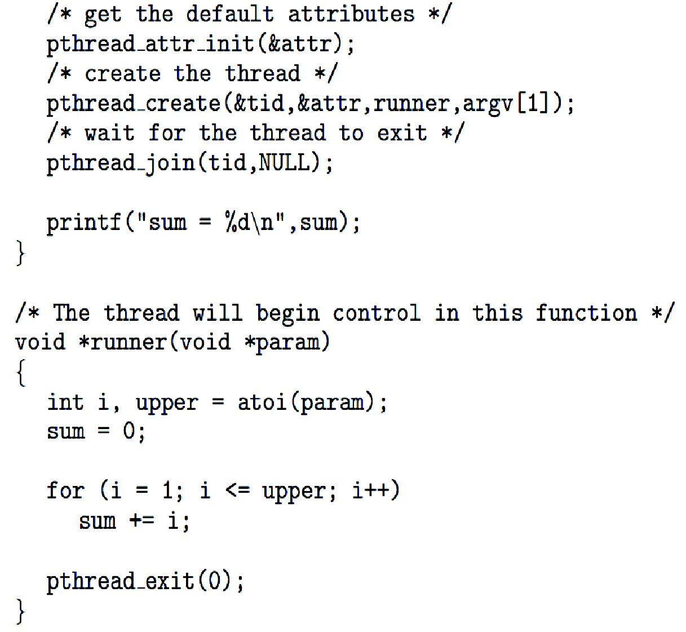
Pthreads Example (Cont.)

Slide 22
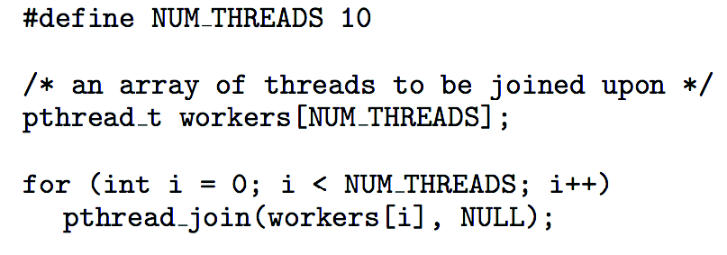
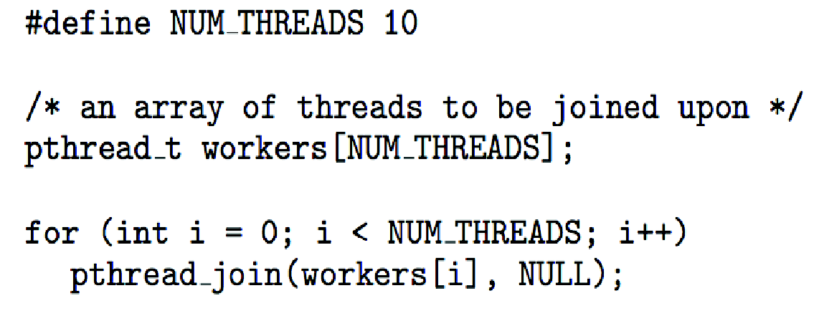
Pthreads Code for Joining 10 Threads

Slide 23
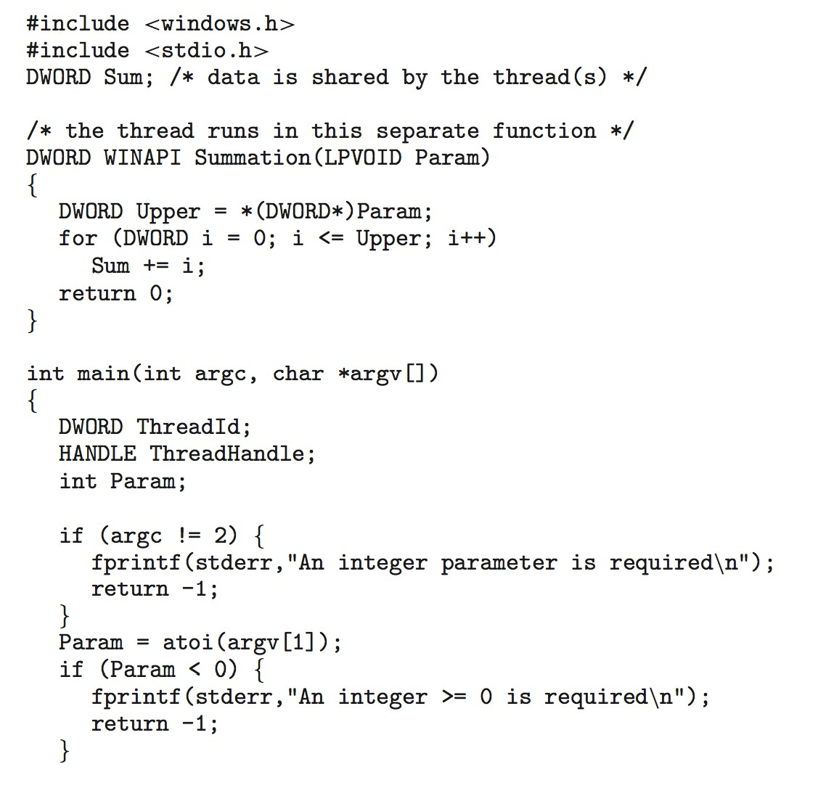
Windows Multithreaded C Program

Slide 24
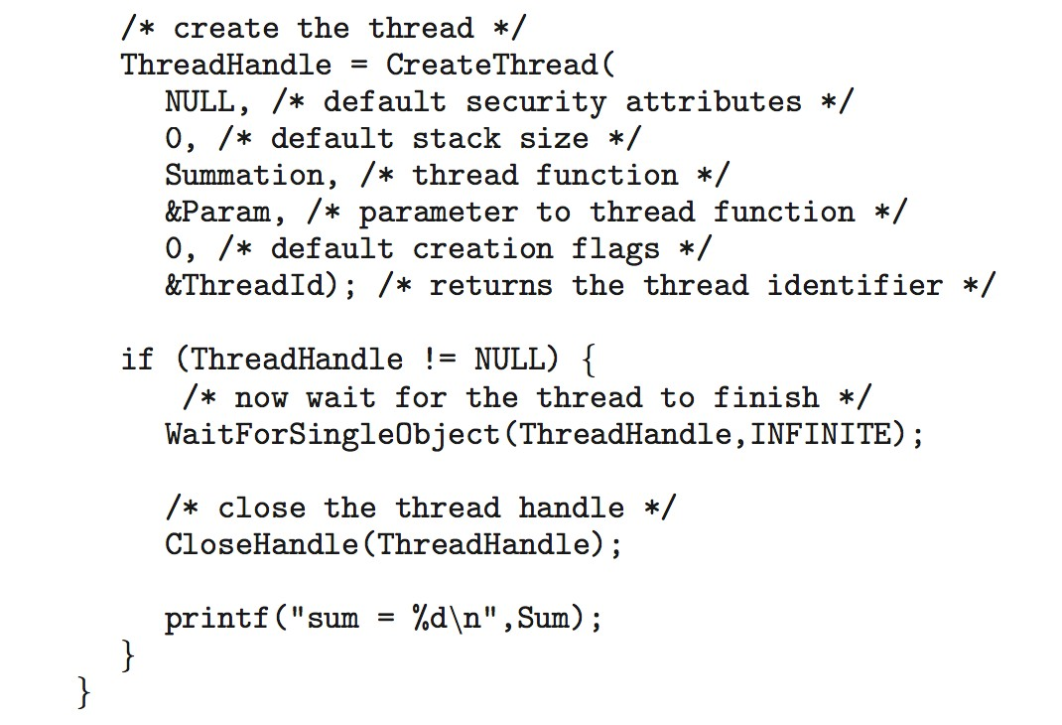
Windows Multithreaded C Program (Cont.)

Slide 25
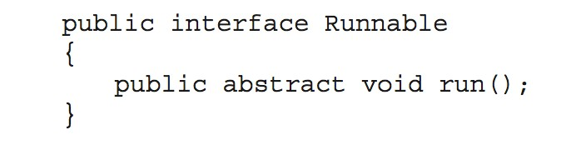
Java Threads
Java threads are managed by the JVM
Typically implemented using the threads model provided by underlying OS
Java threads may be created by:
Extending Thread class
Implementing the Runnable interface

Slide 26
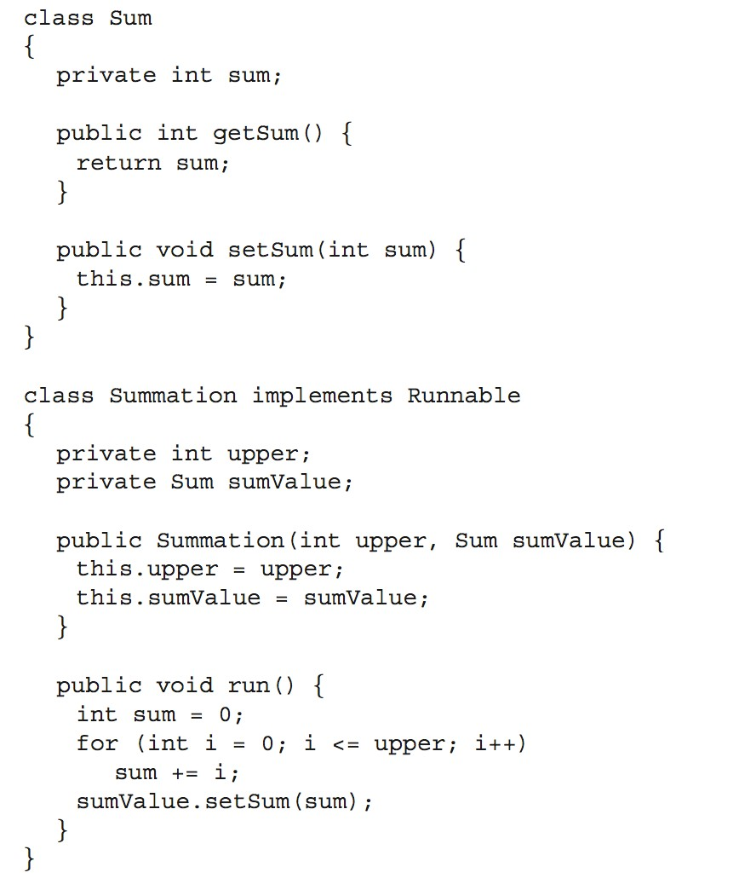
Java Multithreaded Program

Slide 27
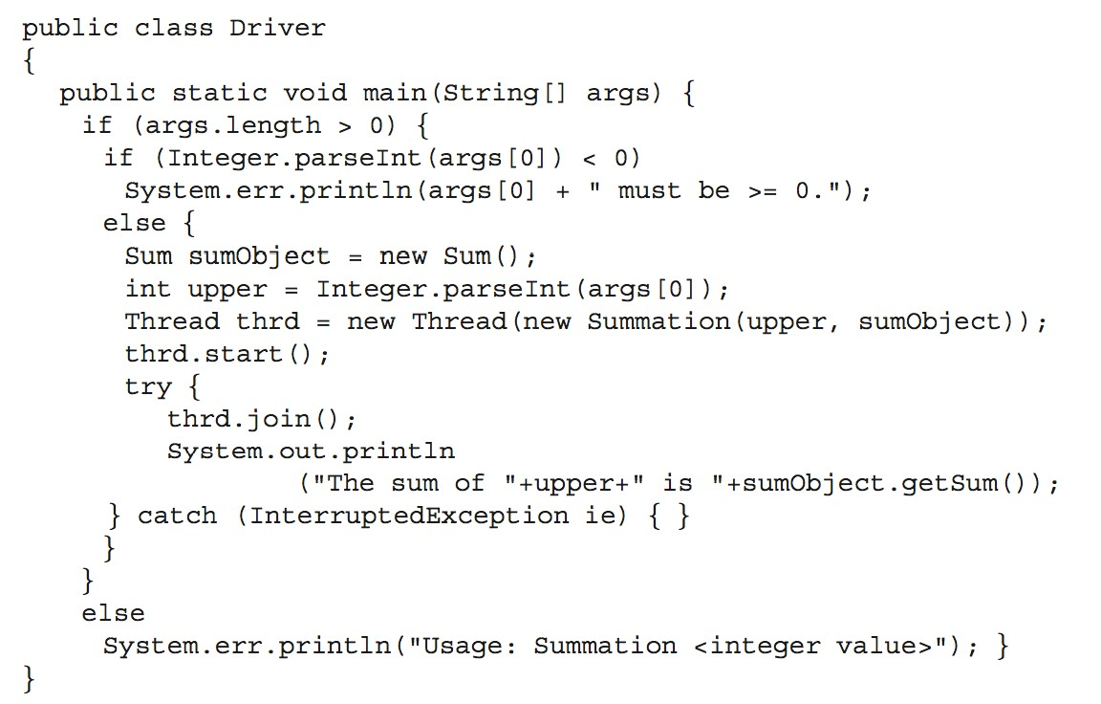
Java Multithreaded Program (Cont.)

Slide 28
Implicit Threading
Growing in popularity as numbers of threads increase, program correctness more difficult with explicit threads
Creation and management of threads done by compilers and run-time libraries rather than programmers
Three methods explored
Thread Pools
OpenMP
Grand Central Dispatch
Other methods include Microsoft Threading Building Blocks (TBB), java.util.concurrent package

Slide 29
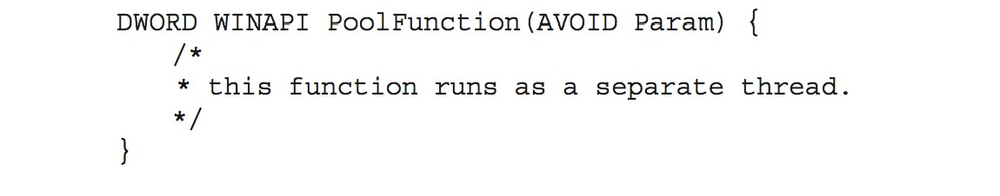
Thread Pools
Create a number of threads in a pool where they await work
Advantages:
Usually slightly faster to service a request with an existing thread than create a new thread
Allows the number of threads in the application(s) to be bound to the size of the pool
Separating task to be performed from mechanics of creating task allows different strategies for running task
 i.e.Tasks could be scheduled to run periodically
Windows API supports thread pools:

Slide 30
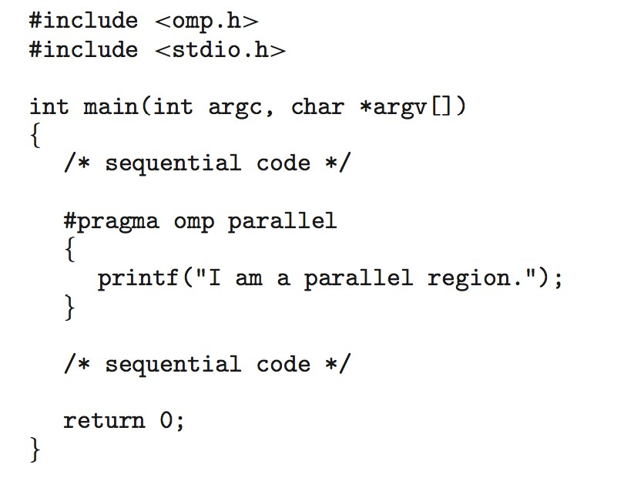
OpenMP
Set of compiler directives and an API for C, C++, FORTRAN
Provides support for parallel programming in shared-memory environments
Identifies parallel regions – blocks of code that can run in parallel
#pragma omp parallel
Create as many threads as there are cores
#pragma omp parallel for for(i=0;i<N;i++) {
c[i] = a[i] + b[i];
}
Run for loop in parallel

Slide 31
Grand Central Dispatch
Apple technology for Mac OS X and iOS operating systems
Extensions to C, C++ languages, API, and run-time library
Allows identification of parallel sections
Manages most of the details of threading
Block is in “^{ }” - ˆ{ printf("I am a block"); }
Blocks placed in dispatch queue
Assigned to available thread in thread pool when removed from queue

Slide 32
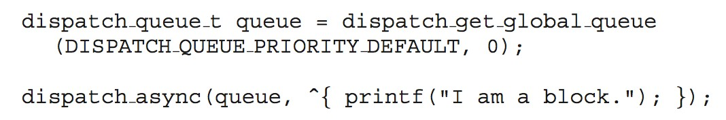
Grand Central Dispatch
Two types of dispatch queues:
serial – blocks removed in FIFO order, queue is per process, called main queue
 Programmers can create additional serial queues within program
concurrent – removed in FIFO order but several may be removed at a time
 Three system wide queues with priorities low, default, high

Slide 33
Threading Issues
Semantics of fork() and exec() system calls
Signal handling
Synchronous and asynchronous
Thread cancellation of target thread
Asynchronous or deferred
Thread-local storage
Scheduler Activations

Slide 34
Semantics of fork() and exec()
Does fork()duplicate only the calling thread or all threads?
Some UNIXes have two versions of fork
exec() usually works as normal – replace the running process including all threads

Slide 35
Signal Handling
Signals are used in UNIX systems to notify a process that a particular event has occurred.
A signal handler is used to process signals
Signal is generated by particular event
Signal is delivered to a process
Signal is handled by one of two signal handlers:
default
user-defined
Every signal has default handler that kernel runs when handling signal
User-defined signal handler can override default
For single-threaded, signal delivered to process

Slide 36
Signal Handling (Cont.)
Where should a signal be delivered for multi-threaded?
Deliver the signal to the thread to which the signal applies
Deliver the signal to every thread in the process
Deliver the signal to certain threads in the process
Assign a specific thread to receive all signals for the process

Slide 37
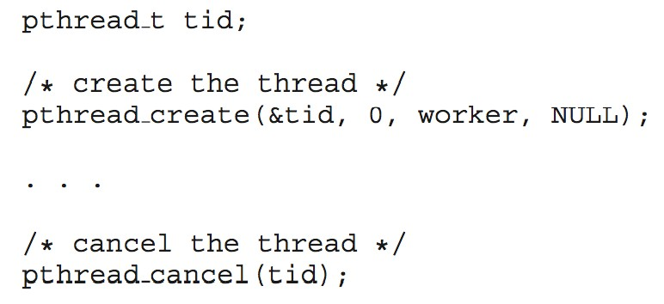
Thread Cancellation
Terminating a thread before it has finished
Thread to be canceled is target thread
Two general approaches:
Asynchronous cancellation terminates the target thread immediately
Deferred cancellation allows the target thread to periodically check if it should be cancelled
Pthread code to create and cancel a thread:

Slide 38
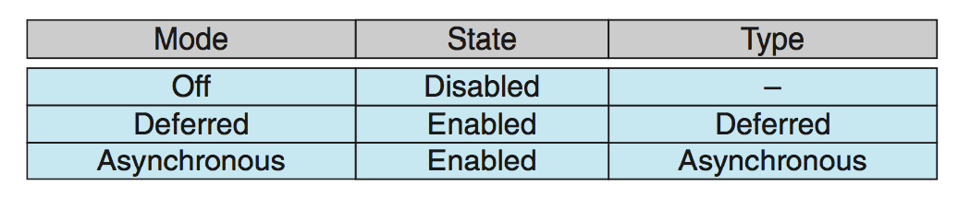
Thread Cancellation (Cont.)
Invoking thread cancellation requests cancellation, but actual cancellation depends on thread state
If thread has cancellation disabled, cancellation remains pending until thread enables it
Default type is deferred
Cancellation only occurs when thread reaches cancellation point
 I.e. pthread_testcancel()
 Then cleanup handler is invoked
On Linux systems, thread cancellation is handled through signals

Slide 39
Thread-Local Storage
Thread-local storage (TLS) allows each thread to have its own copy of data
Useful when you do not have control over the thread creation process (i.e., when using a thread pool)
Different from local variables
Local variables visible only during single function invocation
TLS visible across function invocations
Similar to static data
TLS is unique to each thread

Slide 40
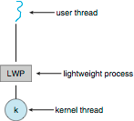
Scheduler Activations
Both M:M and Two-level models require communication to maintain the appropriate number of kernel threads allocated to the application
Typically use an intermediate data structure between user and kernel threads – lightweight process (LWP)
Appears to be a virtual processor on which process can schedule user thread to run
Each LWP attached to kernel thread
How many LWPs to create?
Scheduler activations provide upcalls - a communication mechanism from the kernel to the upcall handler in the thread library
This communication allows an application to maintain the correct number kernel threads

Slide 41
Operating System Examples
Windows Threads
Linux Threads

Slide 42
Windows Threads
Windows implements the Windows API – primary API for Win 98, Win NT, Win 2000, Win XP, and Win 7
Implements the one-to-one mapping, kernel-level
Each thread contains
A thread id
Register set representing state of processor
Separate user and kernel stacks for when thread runs in user mode or kernel mode
Private data storage area used by run-time libraries and dynamic link libraries (DLLs)
The register set, stacks, and private storage area are known as the context of the thread

Slide 43
Windows Threads (Cont.)
The primary data structures of a thread include:
ETHREAD (executive thread block) – includes pointer to process to which thread belongs and to KTHREAD, in kernel space
KTHREAD (kernel thread block) – scheduling and synchronization info, kernel-mode stack, pointer to TEB, in kernel space
TEB (thread environment block) – thread id, user-mode stack, thread-local storage, in user space

Slide 44
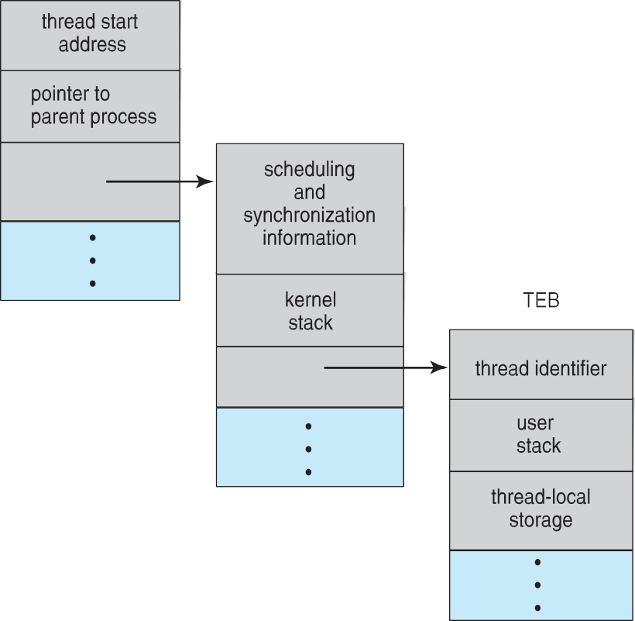
Windows Threads Data Structures

Slide 45
Linux Threads
Linux refers to them as tasks rather than threads
Thread creation is done through clone() system call
clone() allows a child task to share the address space of the parent task (process)
Flags control behavior
struct task_struct points to process data structures (shared or unique)

Slide 46
End of Chapter 4
Operating System Concepts – 9th Edition

